Slide 1

Year-End Report & Dashboard Summary
Presented by
Sheila Hibbs, LPC, CHC
ISK Administrator of Operations

Slide 2
Presentation Outline
Section 1: Demographics of who ISK serves
Section 2: Satisfaction Surveys
Section 3: Performance Indicators
Section 4: Dashboard Performance and Outcomes
Notes:
Lesson descriptions should be brief.

Slide 3
WHO WE SERVE
Fiscal Year 2023-2024 Demographics
Notes:
Example objectives
At the end of this lesson, you will be able to:
Save files to the team Web server.
Move files to different locations on the team Web server.
Share files on the team Web server.

Slide 4
Certified Community Behavioral Health Clinic (CCBHC) 10/01/2023-9/30/2024 CCBHC Served: 8,401 Distinct Individuals
Distinct CCBHC Persons Served by EQI Population

Slide 5
Behavioral Health Urgent Care and Access Center (UCAC) 10/01/2023-9/30/2024
Behavioral Health Urgent Care and Access Center (UCAC)

Slide 6
Total Persons Served: 9,295
The number of persons served increased during FY24 by 1,370 compared to FY23
3,346 individuals were new to the network this fiscal year (never previously served) compared to 1,900 FY23

Slide 7
Total Persons Served: 9,295
ISK Persons Served by Population
ISK Persons Served by Gender

Slide 8
Total Persons Served: 9,295
ISK Persons Served by Race

Slide 9
ISK Mental / Behavioral Health Diagnoses
SED Youth | Count of Persons Served | % of Total Population
PTSD and Trauma | 587 | 42.14%
Major Depressive Disorders | 461 | 33.09%
ADHD | 469 | 33.67%
Anxiety Disorders | 318 | 22.83%
Substance Use Disorders | 63 | 4.52%
Bipolar Disorder | 21 | 1.51%
Autism/Pervasive Developmental Disorder | 35 | 2.51%
Total Service Population | 1,393
MI / SUD Adults | Count of Persons Served | % of Total Population
Substance Use Disorders | 1,750 | 28.87%
Major Depressive Disorders | 2,369 | 39.09%
PTSD and Trauma | 1,716 | 28.31%
Bipolar Disorder | 1,183 | 19.52%
Schizophrenia / Psychotic Disorders | 1,255 | 20.71%
Anxiety Disorders | 1,423 | 23.48%
Total Service Population | 6,061
Notes:
Various health data points are tracked for some individuals served by ISK, depending on program enrollment and other eligibility factors. Some health data tracking was newly implemented with the CCBHC and some was expanded or more consistently emphasized this year.

Slide 10
ISK Mental / Behavioral Health Diagnoses (cont’d)
IDD Adults | Count of Persons Served | % of Total Population
Mild Intellectual Disability | 320 | 45.01%
Moderate ID | 206 | 28.97%
Severe/Profound ID | 88 | 12.38%
Autism/Pervasive Development Disorder | 170 | 23.91%
Chromosomal Abnormality | 43 | 6.05%
Cerebral Palsy | 39 | 5.49%
Anxiety Disorders | 108 | 15.19%
IDD Adults | Count of Persons Served | % of Total Population
ADHD | 55 | 7.74%
Major Depressive Disorder | 86 | 12.10%
Schizophrenia / Psychotic Disorders | 53 | 7.45%
PTSD and Trauma | 30 | 4.22%
Bipolar Disorder | 37 | 5.20%
Sleep Disorder | 1 | 0.14%
Total Service Population | 711
Notes:
Various health data points are tracked for some individuals served by ISK, depending on program enrollment and other eligibility factors. Some health data tracking was newly implemented with the CCBHC and some was expanded or more consistently emphasized this year.

Slide 11
ISK Mental / Behavioral Health Diagnoses (cont’d)
IDD Youth | Count of Persons Served | % of Total Population
Autism/Pervasive Development Disorder | 307 | 62.65%
Mild Intellectual Disability | 57 | 11.63%
Moderate ID | 16 | 3.27%
Severe / Profound ID | 8 | 1.63%
ADHD | 76 | 15.51%
Anxiety Disorders | 22 | 4.49%
PTSD and Trauma | 51 | 10.41%
Major Depressive Disorder | 11 | 2.24%
Total Service Population | 490
Notes:
Various health data points are tracked for some individuals served by ISK, depending on program enrollment and other eligibility factors. Some health data tracking was newly implemented with the CCBHC and some was expanded or more consistently emphasized this year.

Slide 12
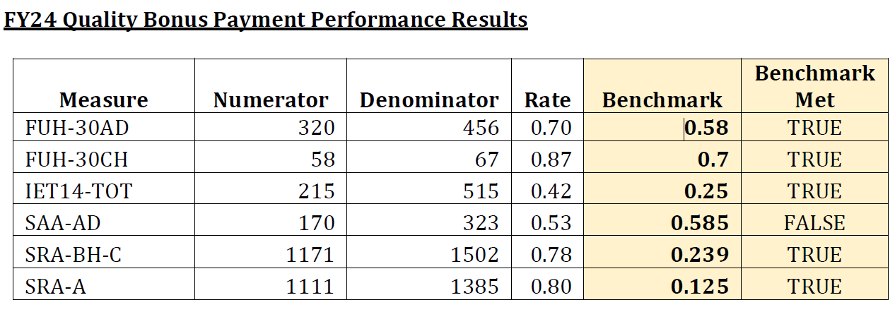
CCBHC Clinic-Reported Quality Performance Measures
FY24 Quality Bonus Payment Required Performance Measures
Follow-Up After Hospitalization for Mental Illness, (FUH-CH) (FUH-AD)*
Initiation and Engagement of Alcohol and Other Drug Dependence Treatment (IET-AD)*
Adherence to Antipsychotic Medications for Individuals with Schizophrenia (SAA-AD)
Child and Adolescent Major Depressive Disorder (MDD): Suicide Risk Assessment (SRA-C) *
Adult Major Depressive Disorder: Suicide Risk Assessment (SRA-A) *
Notes:
Various health data points are tracked for some individuals served by ISK, depending on program enrollment and other eligibility factors. Some health data tracking was newly implemented with the CCBHC and some was expanded or more consistently emphasized this year.

Slide 13
Satisfaction Surveys
Fiscal Year 2023-2024
Youth Services Survey (YSS)
Mental Health Statistics Improvement Plan (MHSIP)

Slide 14
Satisfaction Survey of Persons Served
A nationally adopted, standardized tool designed to assess service recipients’ perception of care across behavioral health services was facilitated through SWMBH for the eight-county region.
Mental Health Statistics Improvement Program (MHSIP) – 531 participants (421 completed, 110 partial)
Youth Satisfaction Survey (YSS) – 189 participants (160 completed, 29 partial)
CCBHC Patient Care Experience and Youth/Family Experience Survey
Feedback collected from these surveys are used as input for planning, designing, modifying and improving services provided to individuals. The results of these surveys are made available to Stakeholders through the ISK portal and public website, as appropriate.
Notes:
Red indicates a decrease in score compared to last FY survey for % in agreement. The difference between last FY survey and this survey was -2.46% overall for % in agreement

Slide 15
Performance Indicators
Michigan Mission-Based Performance Indicator System (MMBPIS)

Slide 16
Persons receiving a Pre-Admission Screening for Psychiatric Inpatient Care for whom the disposition was completed within 3 hours
FY 2024 Data

Slide 17
New persons receiving a completed Biopsychosocial Assessment within 14 calendar days of a non-emergency request for service
FY 2024 Data

Slide 18
New persons starting any needed on-going service within 14 days of completing a non-emergent Biopsychosocial Assessment
FY 2024 Data

Slide 19
Persons discharged from a Psychiatric Inpatient Unit who are seen for follow-up care within 7 days
FY 2024 Data

Slide 20
Persons readmitted to an Inpatient Psychiatric Units within 30 calendar days of discharge from a Psychiatric Inpatient Unit
FY 2024 Data

Slide 21
Dashboard Performance and Outcomes
Fiscal Year 2023-2024

Slide 22
Dashboard Performance and Outcomes

Slide 23
Dashboard Performance and Outcomes

Slide 24
Dashboard Performance and Outcomes

Slide 25
Dashboard Performance and Outcomes
10. Children with Serious Emotional Disturbance (SED) with Significant Improvement
This indicator is no longer applicable due to change in Level of Care Assessment from CAFAS to MichiCANS

Slide 26
Dashboard Performance and Outcomes

Slide 27
Dashboard Performance and Outcomes
# of individuals in Self-Determination arrangements (MIA)
# of individuals in Self-Determination arrangements with Fiscal Intermediary (I/DDA) | 199
# of individuals in Choice Voucher arrangements (I/DDC) | 418
# of individuals in Peer Directed Services | 376
# of individuals in Peer Mentor Services (I/DDA) | 7
# of individuals in Youth Peer or Parent Support Partner Services (SED) | 68
# of individuals in Youth Peer or Parent Support Partner Services (I/DDC) | 7

Slide 28
Dashboard Performance and Outcomes

