Slide 1
Bridging the gaps: A data-driven approach to equitable service delivery
BY:
Sheila Hibbs
Administrator of OPERATIONS
Warwick Barlow
Sr. Manager of Analytics and ehr operations
Cheryl Nebedum
Community outreach and network engagement manager

Slide 2

Preface
This statistical study began with ISK exploring the question of; “How equitably are services being delivered across ZIP codes, racial and ethnic groups, age ranges, and gender identities?”
The inquiry launched a collaborative effort with the Analytics Department, using both internal and public data to examine service patterns, reach, and disparities.
Through modern tools and narrative-focused analysis, we uncovered trends that can guide outreach, inform strategy, and encourage deeper collaboration in 2025 and beyond.

Slide 3

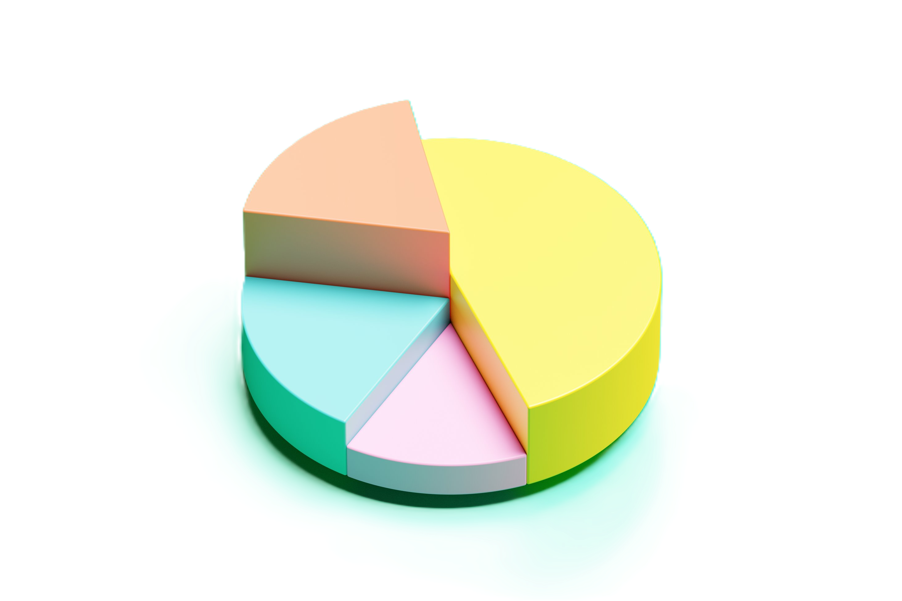
Scope of analysis
This analysis represents the first phase of a broader initiative to explore how different communities engage with ISK services.
We examined:
Penetration rates by ZIP code, by age and race.
Service utilization disparities based on gender identity.
Our goal: to identify gaps in equitable access, spotlight underutilized services, and lay the groundwork for future deep dives into community-level equity.

Slide 4
Dataset
This analysis used service data from 9,302 unique individuals who received care through ISK be it direct programs or Provider Services between October 1, 2023 and September 30, 2024. We calculated averages and demographic distributions from this dataset, then compared them to publicly available U.S. Census ZIP code-level information, including:
Population size
Race / Age representation within ZIP codes
Median household income
Home values
Population density
ZIP Codes Included in Analysis
49001, 49002, 49004, 49006, 49007, 49008, 49009, 49012, 49024, 49034,
49048, 49052, 49053, 49060, 49071, 49074, 49078, 49080, 49083, 49087

Slide 5
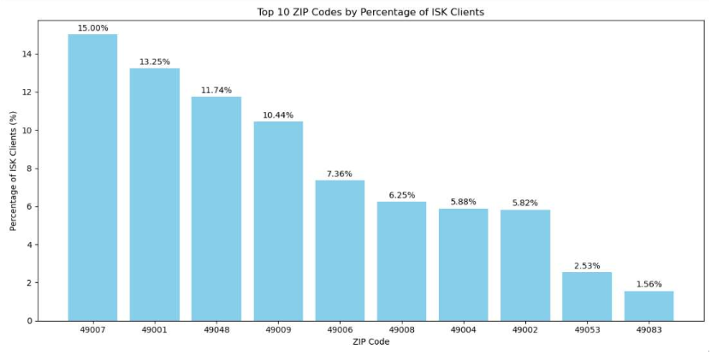
Top 10 zip codes by percentage of ISK clients
Where do the Individuals we serve, live?
49007: 15% of all ISK Clients
49009: 10.44% of all clients
Notes:
We start by analyzing where do our ISK Individuals live. We break that down here, highlight, most ISK served Individuals reside within 49007. On this graph our lowest represented population is 49083.

Slide 6
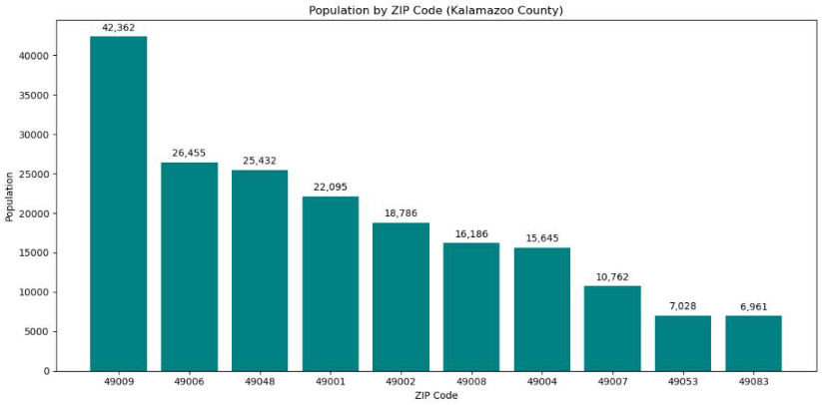
Kalamazoo county population data by zip code – where do people live.
Let’s look at population data for Kalamazoo County. From publicly available census data, Take Away:
49009 has the largest population followed by 49006.
Notes:
On this graph we review actual census level information, not ISK specific info on where do Individuals reside within Kalamazoo County. The largest population reside within 49009.

Slide 7
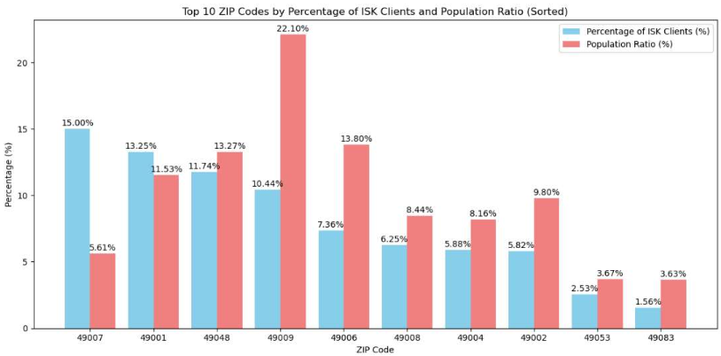
Top 10 zip codes by percentage of ISK Individuals and population ratio of Kalamazoo County
Notes:
This graph, combines the two first graphs into one comparison. We see ISK Individuals served are show in blue, recall that we mentioned that 15% of all ISK Individuals are within 49007. You can see that replicated here in the first blue bar. The Salmon bars show where people who live within Kalamazoo county actually reside. Largest again being the same as our 2nd graph, 49009. This let’s you visualize cleanly, ISK Individuals served, vs the county population. This leads into our next visual, which we highlight the take away here, variance.

Slide 8
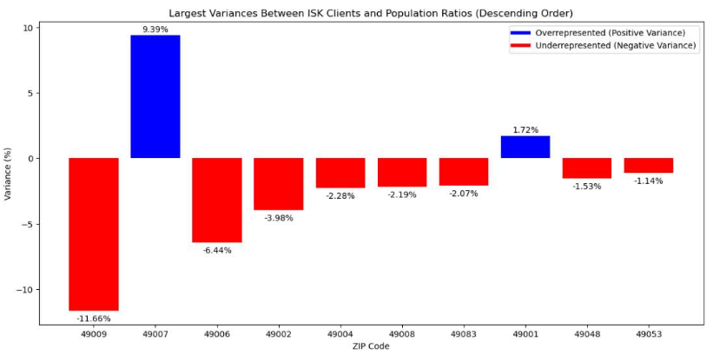
Take away from population analysis of ISK vs Kalamazoo county zips
This chart brings together the insights from the previous three visuals.
It overlays ISK’s client distribution with the general county population by ZIP code, making variance easy to see.
Overrepresented ZIPs are shown in blue, underrepresented in red — highlighting where service reach exceeds or falls short of population share.
Notes:
7
Analyzing ISK Client Representation Across Kalamazoo County
This graph visualizes how ISK’s client population compares to the overall Kalamazoo County population, broken
down by ZIP code. By examining these variances, we can identify:
• Overrepresented ZIP Codes (Blue Bars): Areas where ISK clients make up a disproportionately higher
percentage compared to the general population.
• Underrepresented ZIP Codes (Red Bars): Areas where ISK clients make up a lower percentage relative
to the population.
Understanding these disparities is essential for fostering equity in service delivery. Overrepresentation might
signal strong community engagement or unintentional biases, while underrepresentation could highlight barriers
such as access, awareness, or unmet needs.
This analysis provides a data-driven foundation for identifying patterns, addressing inequities, and tailoring
outreach efforts to better serve all communities. By aligning ISK’s client representation more closely with the
overall population distribution, ISK can ensure a more inclusive and balanced impact across Kalamazoo County

Slide 9
Take Away
These results are an opportunity for ISK clinicians and leadership to discuss the social, economic, and structural factors that may drive over- or underrepresentation in specific areas.
Possible Contributing Factors to Discuss
Access to transportation
Proximity to ISK or contracted service providers
Referral networks (which agencies funnel more clients)
Community awareness or stigma
Outreach intensity (where community teams are most active)
Private insurance availability (might shift care outside ISK)
Language access / cultural barriers
Historical distrust or systemic exclusion
Poverty, economic insecurity

Slide 10
WHO's being reached – and who’s being missed – in 49007

Slide 11
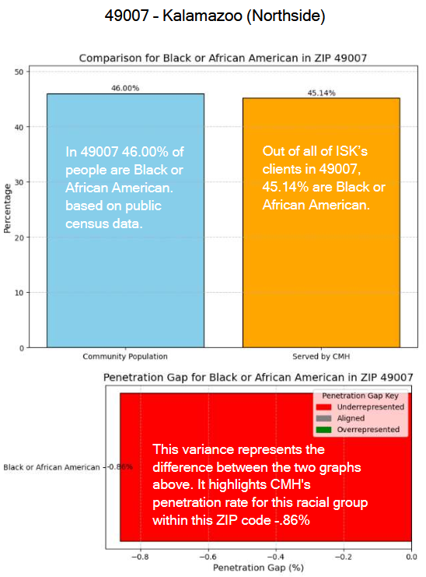
49007 – African American population vs. ISK Service Representation
What This Means:
This chart looks at how ISK is serving African American residents in ZIP code 49007 which includes the Northside and other surrounding neighborhoods.
The blue bar shows that 46% of the total population in 49007 identifies as Black or African American.
The orange bar shows that 45.14% of those served by ISK in that ZIP also identify as Black or African American.
The small difference between these bars — a penetration gap of just 0.86% — means we are very closely matching the makeup of the community.
While a large gap would suggest a group is being underserved, a gap this small shows that we are effectively reaching the African American population in this area.

Slide 12
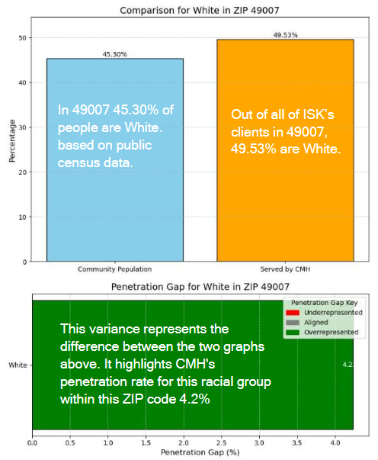
49007 – white population vs. ISK Service Representation
What This Means:
This chart looks at how ISK is serving White residents in ZIP code 49007 (Kalamazoo – Northside).
The blue bar shows that 45.3% of this ZIP code’s total population identifies as White.
The orange bar shows that 49.53% of people receiving CMH services in this area are White.
This creates a penetration gap of +4.2%, meaning White residents are slightly overrepresented in CMH services compared to their share of the local population.
This may suggest:
  Greater outreach or referral access for White residents
  Fewer barriers to getting services
  Or different service needs compared to other groups in the area
A gap like this isn’t necessarily positive or negative — but it helps us identify where outreach and access patterns might differ across communities.

Slide 13
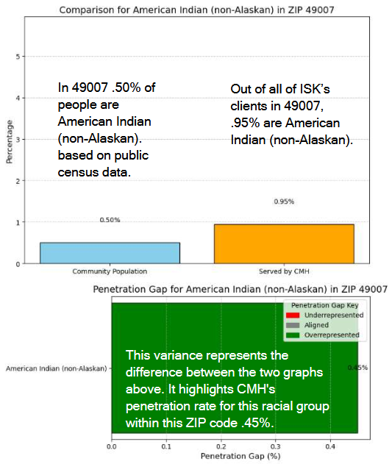
49007 – American Indian (non-Alaskan) population vs. ISK Service Representation
What This Means:
This chart looks at how ISK is serving American Indian (non-Alaskan) residents in ZIP code 49007 (Kalamazoo – Northside).
The blue bar shows that 0.50% of this ZIP code’s total population identifies as American Indian.
The orange bar shows that 0.95% of people receiving CMH services in this area are American Indian.
This creates a penetration gap of +0.45%, meaning this group is utilizing CMH services at nearly twice their representation in the community.
Because the population size is small, even a small increase in service use can cause a noticeable percentage change.

Slide 14
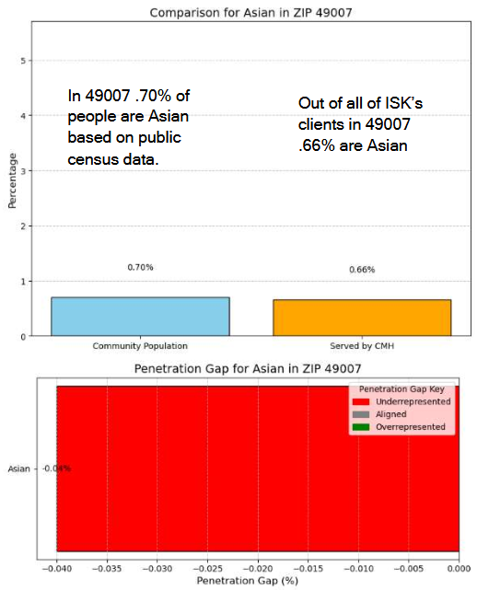
49007 – Asian population vs. ISK Service Representation
What This Means:
This chart looks at how ISK is serving Asian residents in ZIP code 49007 (Kalamazoo – Northside).
The blue bar shows that 0.70% of this ZIP code’s total population identifies as Asian.
The orange bar shows that 0.66% of people receiving CMH services in this area are Asian.
This results in a penetration gap of -0.04%, which is nearly zero — indicating that CMH’s service reach for Asian residents is very closely aligned with their representation in the community.
This near match suggests CMH is neither significantly over- nor under-serving this group. That said, because the overall population size is small, even a few additional clients could shift this percentage noticeably. It may still be valuable to assess whether this alignment reflects true equity in access, or if there are hidden barriers that data alone might not reveal.

Slide 15
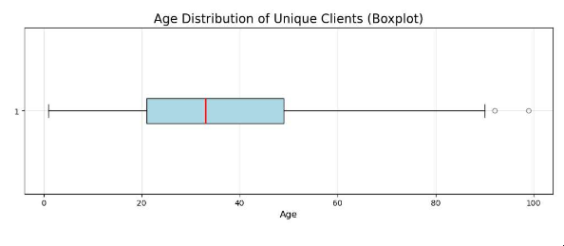
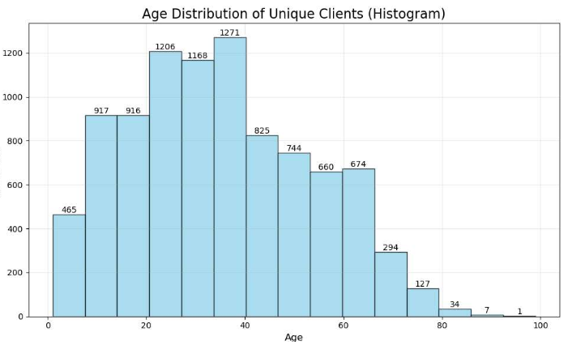
Age distribution of ISK individuals served
Age Analysis of ISK Clients
The mean age is 35.04, the average across all unique clients.
Notes:
This graph, combines the two first graphs into one comparison. We see ISK Individuals served are show in blue, recall that we mentioned that 15% of all ISK Individuals are within 49007. You can see that replicated here in the first blue bar. The Salmon bars show where people who live within Kalamazoo county actually reside. Largest again being the same as our 2nd graph, 49009. This let’s you visualize cleanly, ISK Individuals served, vs the county population. This leads into our next visual, which we highlight the take away here, variance.

Slide 16
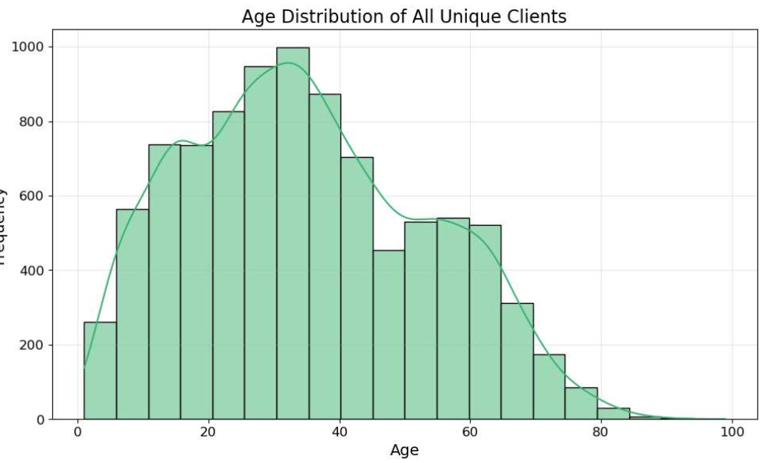
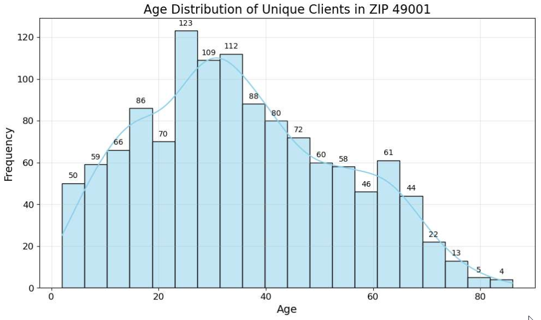
Age distribution of ISK individuals served all clients vs specific zip codes
After analyzing the overall age distribution of all individuals served, we then looked at individual ZIP codes—like 49001—to identify specific ages or age ranges that may be over- or underrepresented in services compared to the broader population.
Notes:
This graph, combines the two first graphs into one comparison. We see ISK Individuals served are show in blue, recall that we mentioned that 15% of all ISK Individuals are within 49007. You can see that replicated here in the first blue bar. The Salmon bars show where people who live within Kalamazoo county actually reside. Largest again being the same as our 2nd graph, 49009. This let’s you visualize cleanly, ISK Individuals served, vs the county population. This leads into our next visual, which we highlight the take away here, variance.

Slide 17
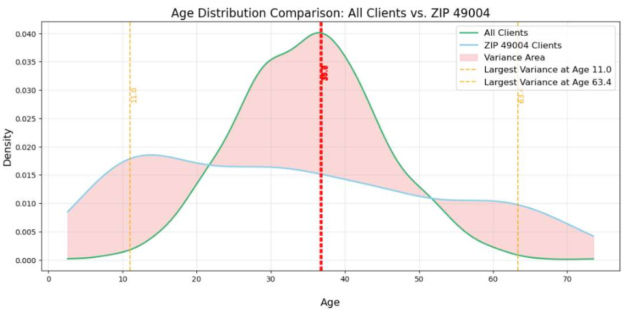
End Product: Identifying Age-Based Service Gaps in ZIP 49004
What This Means:
This chart compares the normalized age distributions of all unique ISK clients and those specifically from ZIP code 49004. It highlights where certain age groups in 49004 are over- or underrepresented relative to the full client population.
The largest differences in the younger age range (5–20) occur at age 11, and for older adults (55–70), the greatest gap appears around age 63. The most significant overall variances are seen between ages 36 and 37 — where the proportion of 49004 clients diverges most from what we’d expect based on system-wide patterns.
The shaded areas on the chart show where these differences occur, helping identify potential service gaps and guiding opportunities for more targeted outreach.
Notes:
If the question of did we normalize the distribution of this data arises, it’s a fairly heavy technical answer. Yes, I did not simply compare raw counts of how many clients are say 11 in 49004 vs how many clients are 11 in our entire Individual data set. Instead we used Kernel Density Estimation to create curves showing how client spread across ages. We looked at what percent of all clients are age 11 vs what percent of all clients in 49004 are age 11. This allows us to compare the shape of the age distribution This removes the impact of population size differences and gives us a true picture of what ages are over and under represented.
Kernel Density Estimation (KDE) is a way to look at the shape of data, rather than just raw counts.
It smooths out the values and helps us see patterns — like which ages are more or less common — even when we’re comparing groups of very different sizes.
So instead of just counting clients at each age, KDE looks at what percent of each population falls into each age range. That way, when we compare ZIP 49007 to our full client base, we’re not skewed by the fact that one group is much smaller — we’re comparing the age distribution shapes, not raw totals.
This allows us to say things like, “ZIP 49007 has proportionally fewer 11-year-olds than expected,” in a way that’s fair — because we’re comparing percentages, not headcounts.

Slide 18
Exploring Gender Identity and Service Utilization Disparities at ISK
We analyzed gender identity across ISK’s clients, focusing on service access between cisgender and non-cisgender groups.
To ensure fairness, we:
  Deduplicated clients to their most recent visit
  Standardized gender categories
  Grouped clients into:
  • Cisgender (Man/Woman)
  • All Other Gender Identities
We compared service usage across both groups using normalized per-client rates (not raw totals) to reveal disparities.
Key findings are visualized through bar charts showing where non-cisgender clients may be underrepresented in service access — helping us identify gaps and ensure equitable delivery across all gender identities.

Slide 19
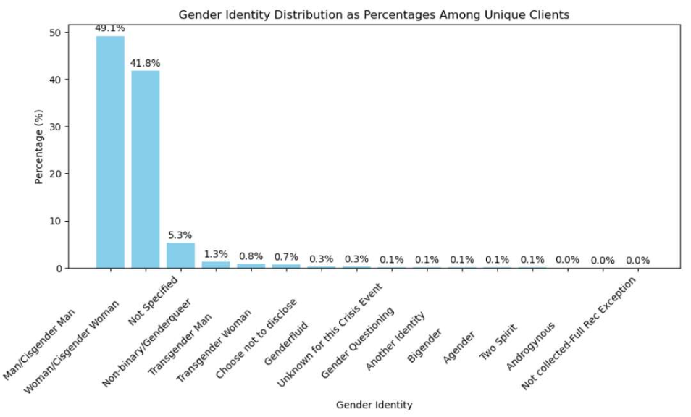
Gender identity distribution as percentages among individuals
For this analysis, we grouped clients into two categories:
• Cisgender – those who explicitly selected ‘Man/Cisgender Man’ or ‘Woman/Cisgender Woman’ (90.9% of clients)
• Did Not Identify as Cisgender – everyone else, including those who chose ‘Not Specified’
This grouping allows us to fairly compare service utilization patterns across gender identity disclosure, rather than assuming identity or excluding individuals from the analysis.”

Slide 20
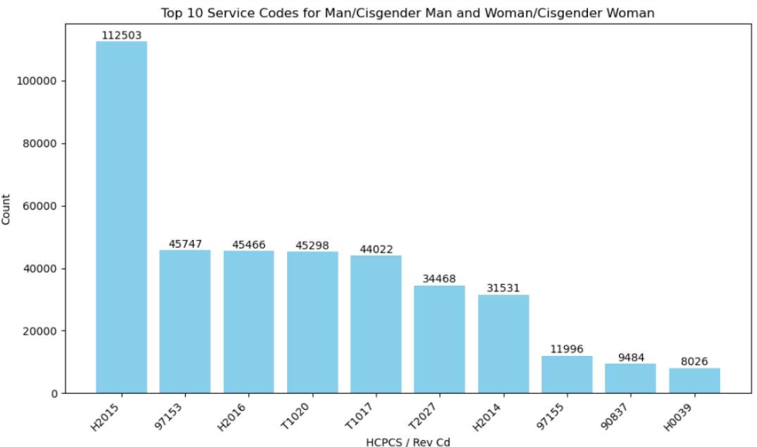
Top 10 services per group – Cis gender identity.
Notes:
This graph, combines the two first graphs into one comparison. We see ISK Individuals served are show in blue, recall that we mentioned that 15% of all ISK Individuals are within 49007. You can see that replicated here in the first blue bar. The Salmon bars show where people who live within Kalamazoo county actually reside. Largest again being the same as our 2nd graph, 49009. This let’s you visualize cleanly, ISK Individuals served, vs the county population. This leads into our next visual, which we highlight the take away here, variance.

Slide 21
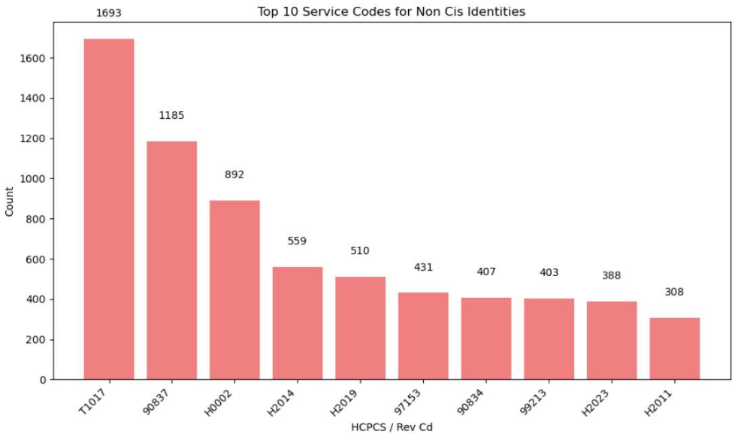
Did Not Identify as Cisgender
Notes:
This graph, combines the two first graphs into one comparison. We see ISK Individuals served are show in blue, recall that we mentioned that 15% of all ISK Individuals are within 49007. You can see that replicated here in the first blue bar. The Salmon bars show where people who live within Kalamazoo county actually reside. Largest again being the same as our 2nd graph, 49009. This let’s you visualize cleanly, ISK Individuals served, vs the county population. This leads into our next visual, which we highlight the take away here, variance.

Slide 22
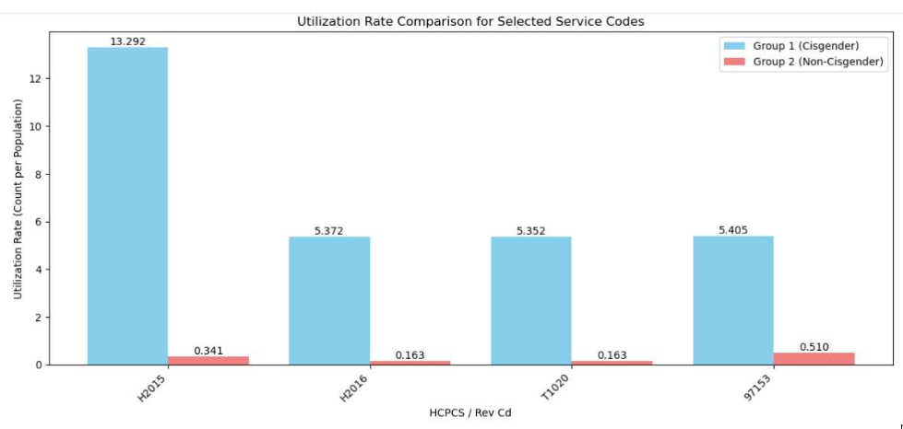
Conclusion of service delivery among the two groups
To accurately compare service access between cisgender and non-cisgender clients, we calculated per-client utilization rates rather than relying on total service counts.
Using H2015 as an example:
Cisgender clients received this service 13.29 times per person
Non-cisgender clients received it just 0.34 times per person
This results in a 39:1 utilization gap, revealing a significant disparity in how services are accessed or delivered.
This pattern is not unique to H2015 — similar gaps appear across other high-volume services, raising important questions about equity and access for gender-diverse individuals.
Contextual Note on Data Interpretation:
There is often significant stigma associated with identifying as non-cisgender, which may lead clients to withhold or simplify their gender identity when receiving services. As a result, some individuals categorized as "cisgender" in our data may not actually identify that way.
This underreporting can distort service utilization comparisons and obscure true equity gaps. We recommend agencies prioritize improving gender identity data collection practices to ensure greater accuracy, comfort in disclosure, and better-informed equity efforts.
Notes:
Slide Text (final takeaway):
To accurately compare service access between cisgender and non-cisgender clients, we calculated per-client utilization rates rather than relying on total service counts.
Using H2015 as an example:
Cisgender clients received this service 13.29 times per person
Non-cisgender clients received it just 0.34 times per person
This results in a 39:1 utilization gap, revealing a significant disparity in how services are accessed or delivered.
This pattern is not unique to H2015 — similar gaps appear across other high-volume services, raising important questions about equity and access for gender-diverse individuals.
Calculations on ratios:
How We Calculated Utilization Rate Ratios:
Counted Total Instances of the service (e.g., H2015) for each group
Cisgender clients: 112,503 instances
Non-cisgender clients: 288 instances
Divided by the Number of Unique Clients in each group
Cisgender: 8,464 clients → 112,503 ÷ 8,464 = 13.29 uses per person
Non-cisgender: 845 clients → 288 ÷ 845 = 0.34 uses per person
Calculated the Ratio between the two rates
13.29 ÷ 0.34 = 38.99 →
→ Cisgender clients received H2015 nearly 39x more often per person
This approach controls for population size, allowing a fair, apples-to-apples comparison of how frequently services are used per client — not just raw totals, which would mislead due to the size difference between groups.

Slide 23
Service codes with highest utilization rate gaps explained
H2015 – Community Support Services (15 min)
Support for daily living skills, case management, and behavioral support. Delivered in home/community settings.
H2016 – Community Support Services (Per Diem)
Same as H2015 but billed per day. Used for higher-intensity or bundled services.
T1020 – Personal Care Services (Per Diem)
Non-medical help with activities like bathing, dressing, mobility. Typically, in-home care.
97153 – Adaptive Behavior Treatment (15 min)
1:1 behavioral therapy for autism, delivered by a technician under BCBA supervision.

Slide 24
How we are using this data to drive initiatives - becoming a data driven agency in practice
Data is being used to assure equitable, inclusive and supportive service delivery
IT Improvements to enhance data collection
Utilizing data will enhance strategies for outreach efforts. Example AA males needing SUD services
Reducing Barriers
Fighting Stigma
Notes:
Reducing barriers or boundaries

Slide 25

The Community Engagement Manager will work closely with the ISK leadership team, data analytics team, community partners and recipients of services to service needs are addressed and gaps in services are identified.
The focus for our community engagement effort will be driven by data, strategic conversations, customer service surveys and need.
We want to achieve outcomes for our engagement activities that align with the strategic plan, agency and community need and in support of those we serve.
To provide focus for this role, the Community engagement manager created 4 main areas to begin our work

Slide 26
Engagement and Outreach quadrants
1 Data driven engagement and outreach (at risk and underrepresented individuals in our community) | 2 Program Specific engagement and outreach (In collaboration with ISK program areas for specific targets)
3 Relationship building engagement and outreach (attending events, representing ISK, support for other organization's initiatives) | 4 Recipient focused outreach and engagement (Focus groups, collaboration with customer service and others)
Data driven engagement and outreach. (at risk-underrepresented individuals in our community) | Program Specific engagement and outreach. (In collaboration with ISK program areas for specific targets)
Relationship building engagement and outreach (attending events, representing ISK, support for other organizations) | Recipient focused outreach and engagement (Focus groups, collaboration with customer service and others)
Notes:
Slide Text (final takeaway):
To accurately compare service access between cisgender and non-cisgender clients, we calculated per-client utilization rates rather than relying on total service counts.
Using H2015 as an example:
Cisgender clients received this service 13.29 times per person
Non-cisgender clients received it just 0.34 times per person
This results in a 39:1 utilization gap, revealing a significant disparity in how services are accessed or delivered.
This pattern is not unique to H2015 — similar gaps appear across other high-volume services, raising important questions about equity and access for gender-diverse individuals.
Calculations on ratios:
How We Calculated Utilization Rate Ratios:
Counted Total Instances of the service (e.g., H2015) for each group
Cisgender clients: 112,503 instances
Non-cisgender clients: 288 instances
Divided by the Number of Unique Clients in each group
Cisgender: 8,464 clients → 112,503 ÷ 8,464 = 13.29 uses per person
Non-cisgender: 845 clients → 288 ÷ 845 = 0.34 uses per person
Calculated the Ratio between the two rates
13.29 ÷ 0.34 = 38.99 →
→ Cisgender clients received H2015 nearly 39x more often per person
This approach controls for population size, allowing a fair, apples-to-apples comparison of how frequently services are used per client — not just raw totals, which would mislead due to the size difference between groups.

Slide 27
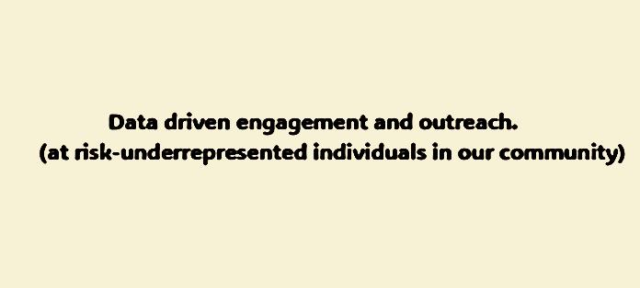
quadrant #1- Data driven outreach and engagement-
T
Data will be used to guide our engagement activities to assure all segments of our community that want our services, are aware of what we offer, know how to access the services ,and have a voice in sharing their experience with our services.
Data will be used along with targeted conversations in each area where data shows low utilization of services and where stigma, poverty and violence is widespread.
We will also be working to connect with rural areas where access to services has unique challenges.
Strategic conversations with community organizations about the data in comparison to their experiences.

Slide 28
Future Outreach ideas:
Individuals with Disabilities.
  Vision Impaired
  Hearing Impaired
  Physical Impairments
Gender Disparity in Services in ZIP Codes.

Slide 29
Thank you
Sheila Hibbs
Administrator of Operations
Warwick Barlow
Sr. Manager of Analytics and ehr operations
Cheryl Nebedum
Community outreach and network engagement manager

